Slide 1

Table Name
Table Description
Input Data Structure
Tables
Column Name
Column Description
In this we talk about the structure of input json file and need for data pre-processing.
Raw Data
Detail About Input Data
Basically, input data is a json file which is consist of 10 tables (products, sales, employee, customer,... ) with their description along with column names, column description and raw data related to that table.
Pre-processing data
Here we have converted json file to pdf format (unstructure format). In this step we are only deal with table name, table description, column name and column description.This pdf is intermediate data on which we trained LLM model. The thing is we can also give json to model directly but for more accuracy we did this step.
For getting more idea about data set refer this link

Slide 2





Deep understanding about work flow and algorthim
  Model Info.
  Vectorstore -> ChromaDb
  Feature Exraction Model -> Bge-base-en-v1.5 (from hugging face)
  Text Generation Model -> Mistral-7B-Instruct-v0.3 (from hugging face)
Users
Question
Compute Embeddings
Generated Response
pre-processing and conversion to pdf document
Ensemble Retreiver
Semantic Search
Input Json File
Vector Embedding
Build semantic
index
LLM
Knowledge
Base
Keyword Search
Re-ranked
Result
Context
For getting more idea about code refer this link

Slide 3

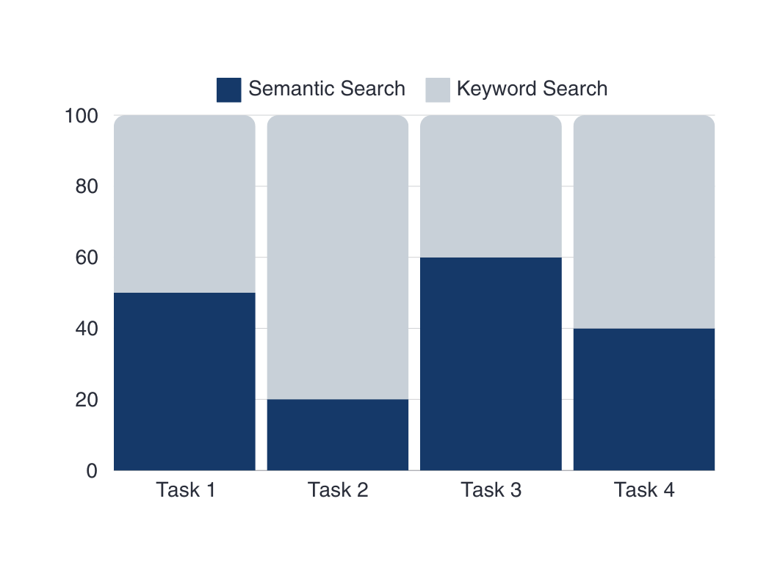
Our Purpose
Briefly elaborate on what you want to discuss.
Task 1->SAME DESCRIPTION DIFFERENT COLUMN OUTPUT
We have kept 50 -50 % weightage to both semantic (Will help in getting relationship by desciption of coulmn) and keyword search (will help in getting relationship by Name of the column)

Slide 4
OUTPUT OF QUERIES
CASE 2. SAME COLUMN NO DESCRIPTION OUTPUT
CASE 1.SAME DESCRIPTION DIFFERENT COLUMN OUTPUT
Query: Give me foreign key relationship with Sales table and other table
Query: Give me foreign key relationship with department table and other table
1. buyer_id: This column in the sales table is a foreign key that references the client_id column in the customers table. This relationship allows us to link a sale to a specific customer.
2. transaction_product_id: This column in the sales table is a foreign key that references the product_code column in the products table. This relationship allows us to link a sale to a specific product.
3. sales_rep: This column in the sales table is a foreign key that references the employee_id column in the employees table. This relationship allows us to link a sale to a specific sales representative.
4. delivery_status: This column in the sales table is a foreign key that references the status column in the delivery_statuses table. This relationship allows us to link a sale to a specific delivery statushat each sale involves a product, and the product is stored in the `products` table.
1. `employees` table: The `manager_id` column in the `employees` table is a foreign key that references the `department_id` column in the `departments` table. This means that each employee has a department manager, and the department manager is a department in the `departments` table.
2. `departments` table: The `location` column in the `departments` table is not a foreign key, but it could be used to establish a relationship with other tables, such as `warehouses` or `stores`, if those tables have a `location` column as well.
3. `inventory` table: The `warehouse_location` column in the `inventory` table could be a foreign key that references the `location` column in the `departments` table, if the warehouse or storage facility is associated with a specific department.
4. `marketing_campaigns` table: The `region` column in the `marketing_campaigns` table could be a foreign key that references the `location` column in the `departments` table, if the marketing campaigns are targeted based on department locations.
CASE 3. SAME COLUMN DIFFERENT DESCRIPTION OUTPUT
CASE 4. DIFFERENT COLUMN NO DESCRIPTION OUTPUT
Query: Give me foreign key relationship with department table and other table
Query: Give me foreign key relationship with department table and other table
1. `employees` table: The `manager_id` column in the `employees` table is a foreign key that references the `employee_id` column in the `departments` table. This means that each employee has a department manager, and the manager is an employee in the `employees` table.
2. `departments` table: The `manager_id` column in the `departments` table is a foreign key that references the `employee_id` column in the `employees` table. This means that each department has a manager, who is an employee in the `employees` table.
3. `sales` table: The `customer_id` column in the `sales` table is a foreign key that references the `customer_id` column in the `customers` table. This means that each sale is made by a customer, and the customer is stored in the `customers` table.
4. `sales` table: The `product_id` column in the `sales` table is a foreign key that references the `product_id` column in the `products` table. This means that each sale involves a product, and the product is stored in the `products` table.
1. employees table:
- manager_id (in employees table) is a foreign key referencing department_id (in departments table). This establishes a relationship between the employees and departments tables, where an employee's manager is associated with a specific department.
2. departments table:
- No foreign keys are defined in the departments table.
3. inventory table:
- product_id (in inventory table) is a foreign key referencing product_id (in products table). This establishes a relationship between the inventory and products tables, where the inventory records are linked to specific products.
4. sales table:
- product_id (in sales table) is a foreign key referencing product_id (in products table). This establishes a relationship between the sales and products tables, where the sales records are linked to specific products.
For getting more idea about code refer this link

